Slide 1
Third pass analysis
Human samples:
Control: K70 (3 samples)
P10-treated: K70P10 (2 samples, sample#3 removed)
MD-treated: K70MD (3 samples)
Purpose:
To validate P10 and MD as inhibitors of the NRF2 pathway in human ESCC cells
To find additional pathways affected by P10 and/or MD for future studies

Slide 2
Analyses
Generate a DEG list (DEG1) by comparing K70 vs K70P10 (p<0.01; log2FC>1 or <-1)
Generate a DEG list (DEG2) by comparing K70 vs K70MD (p<0.01; log2FC>1 or <-1)
Use David’s gene list as DEG3 (229 positive and 5 negative). Note: Positive genes are upregulated in NRF2^{high} ESCC as compared with NRF2^{low} ESCC, and negative genes are downregulated. Therefore these 234 genes may be designated as NRF2-responsive genes in human ESCC.
PCA of K70 (3 samples), K70MD (3 samples), and K70P10 (2 samples) to show distinct clustering
VENN diagram
DEG1 and DEG2: 理论上DEG2应该包括>=50% DEG1
DEG1 and DEG3: 说明P10处理细胞后，那些变化的基因中有多少受NRF2调控？
DEG2 and DEG3: 说明MD处理细胞后，那些变化的基因中有多少受NRF2调控？
DEG1, DEG2 and DEG3：说明P10或MD处理细胞后，那些共同变化的基因中有多少受NRF2调控？

Slide 3
Analyses -- continued
Heatmap
用DEG3（234个基因）做K70，K70P10，K70MD，共8个标本
用DEG1/DEG2/DEG3 overlap的基因，做K70，K70P10，K70MD，共8个标本
Pathway analysis
DEG1做pathway analysis证明, P10 treatment downregulates NRF2 pathway and downregulates/upregulates some other pathways
DEG2做pathway analysis，证明MD treatment downregulates NRF2 pathway and downregulates/upregulates some other pathways
DEG3做pathway analysis，佐证这个list确实是NRF2 pathway（当然会包括一些其它通路，而且所谓NRF2 pathway是一大类，在数据库里会显示为很多不同名字的通路，比如redox regulation, response to oxidative stress, drug metabolism, …）

Slide 4
Mouse samples
Samples
SH (3 samples)
AG (3 samples)
Objectives
to find differentially expressed genes and pathways due to AG treatment in mouse cells
Analysis
PCA: to show SH samples and AG samples cluster in two distinct groups. If not, some samples may be eliminated in the following analyses.
DEG4 (p<0.01, log2FC>1 or <-1)
Heatmap using DEG4
Pathway analysis: to find what pathways may be upregulated/downregulated by AG treatment.

Slide 5
Analysis update
STAR → DEseq2
Salmon → quantitative method?

Slide 6
Finalize DESeq2 protocol

Slide 7
DEG list 2
2550 DEGs
447 DEGs
2016 DEGs
1727 DEGs

Slide 8
DEG list 1
421 DEGs
258 DEGs

Slide 9
DEG list 1
1990 DEGs

Slide 12
AKR1B10 AKR1C2 AKR1C3 COX5B DBI JTB NAA38 NT5C ODC1 OSGIN1 PGD PTDSS1 SLC7A11 TKT TMEM14A

Slide 13
Luke’s analysis on DEGs lists
Group 1
MDDEG: 1727 genes
P10DEG: 1990 genes
MDDEG-P10DEG overlap: 531 genes
Group 2
ESCCNRF2 gene: 234 genes
MDDEG-ESCCNRF2 overlap: 47 genes
P10DEG-ESCCNRF2 overlap: 43 genes
Group 3
NRF2 RNAseq (mouse esophagus): 1940 genes
With_human_homolog: 1557
MDDEG-RNAseq overlap: 184 (185)genes
P10DEG-RNAseq overlap: 209 genes

Slide 16
102 DEGs
220 DEGs
63 DEGs
125 DEGs

Slide 18
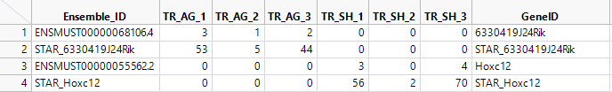

Slide 19
Third pass stops here

Slide 20
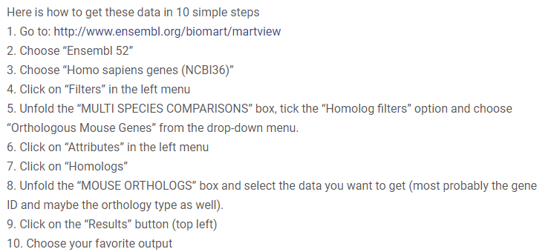
Get homologue from ensembl

Slide 21
83 DEGs
40 DEGs
661 DEGs
484 DEGs

Slide 22
102 DEGs
220 DEGs
63 DEGs
125 DEGs

Slide 23
K70_vs_K70MD_pvalue01_fc4 - DEGs (2016)

Slide 24
K70_vs_P10_pvalue05_fc4 - DEGs (421)
Notes:
P10_3 could be an outlier!!

Slide 25
K70_vs_NKO70_pvalue05_fc2 - DEGs (661)
Notes:
NKO have most down-regulated genes
P70_1_2: have up-regulated genes, P70_3 are more like MD

Slide 26
DDIT4,GJB4, IL21R ,MAP3K7CL, MOBP, ODAPH ,RAET1L, RFX8, SPINK2, SPINK6, SYTL2, ZBED2
LINC01204, LINC02321
LOC101929128, LOC102546229, LOC105379051

Slide 27
DEGs were selected at
adjusted p-value < 0.01
and FC > 2

Slide 28
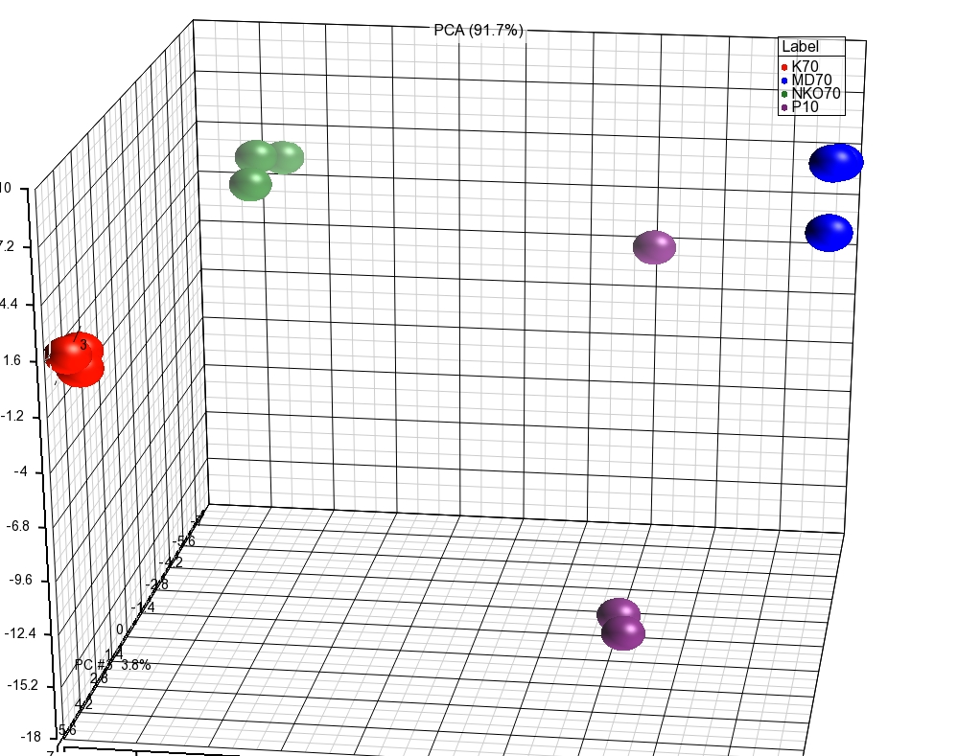
Common DEGs (K70MD & K70P10) – 593 genes

Slide 29
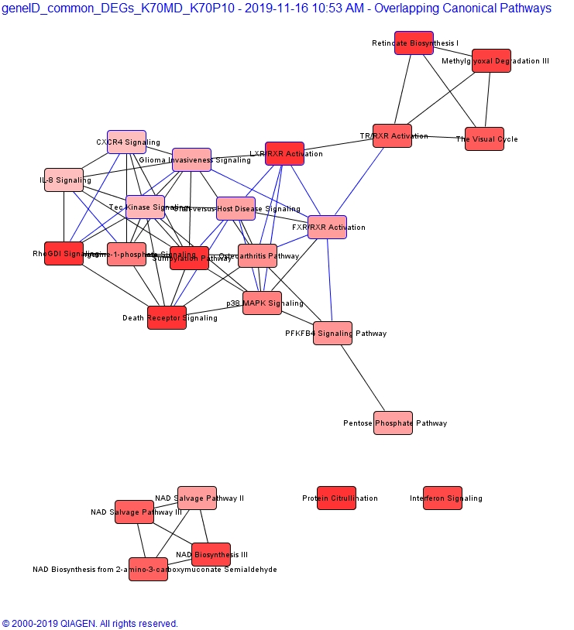

Slide 30
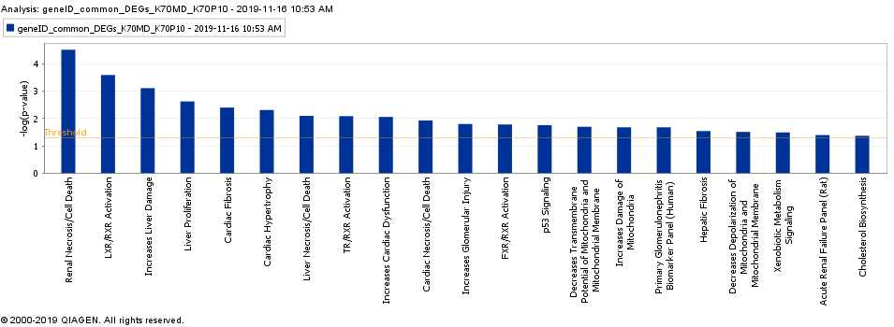

Slide 31
DEGs were selected at
adjusted p-value < 0.01
and FC > 2
DEGs were selected at
adjusted p-value < 0.01
and FC > 4

Slide 32
DEGs for K70MD were selected at
adjusted p-value < 0.01, and FC > 4
DEGs for P10 were selected at
adjusted p-value < 0.01, and FC > 2
DEGs were selected at
adjusted p-value < 0.01
and FC > 4
Notes:
None of 196 overlap with PAM50!!

Slide 33
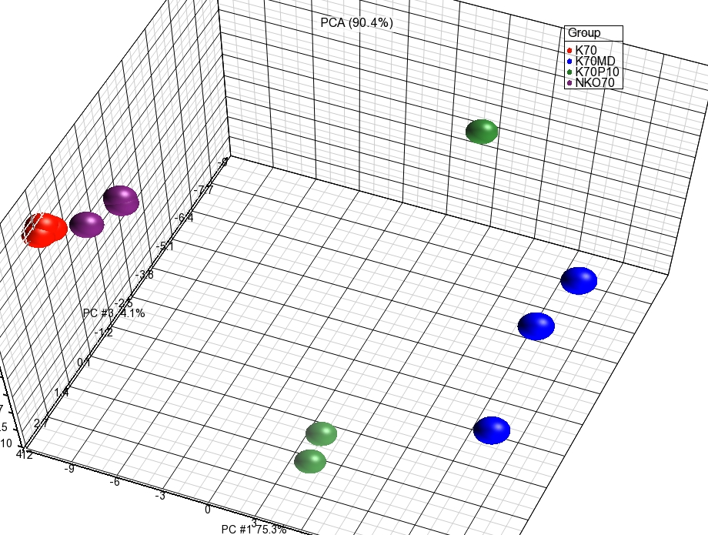
ESCC_196_signatures

Slide 34
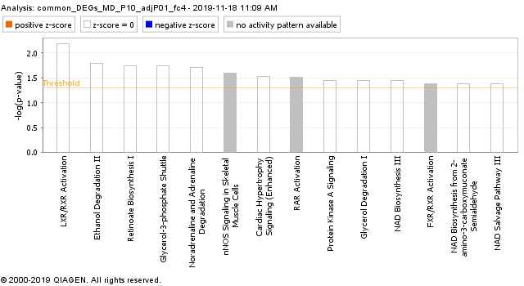
ESCC_196_signatures

Slide 35
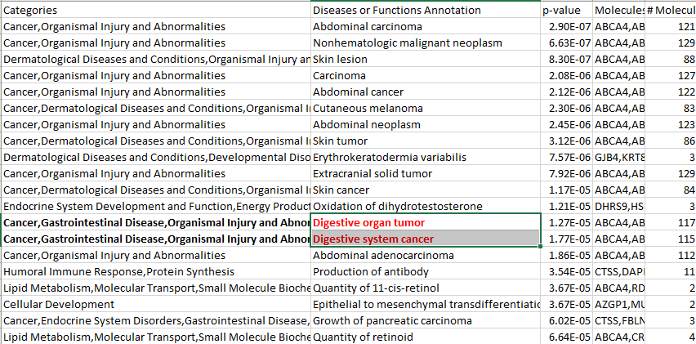
IPA – disease related results (ESCC_196_signatures)

Slide 36
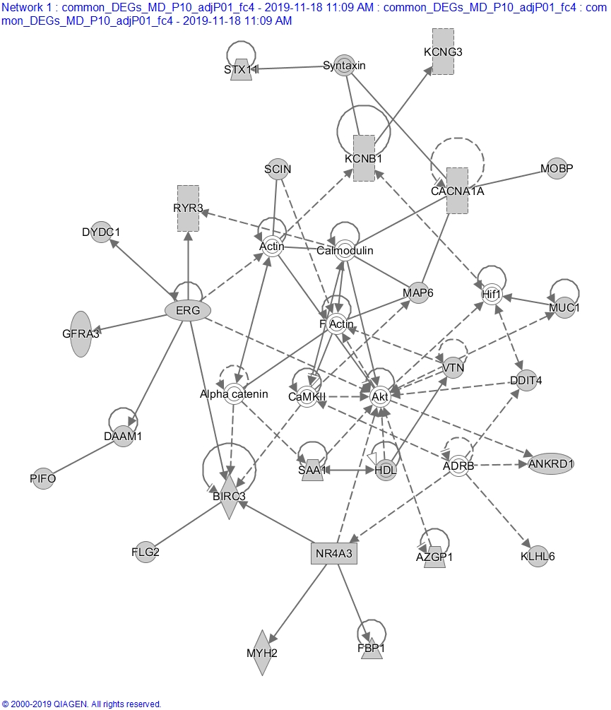

Slide 37
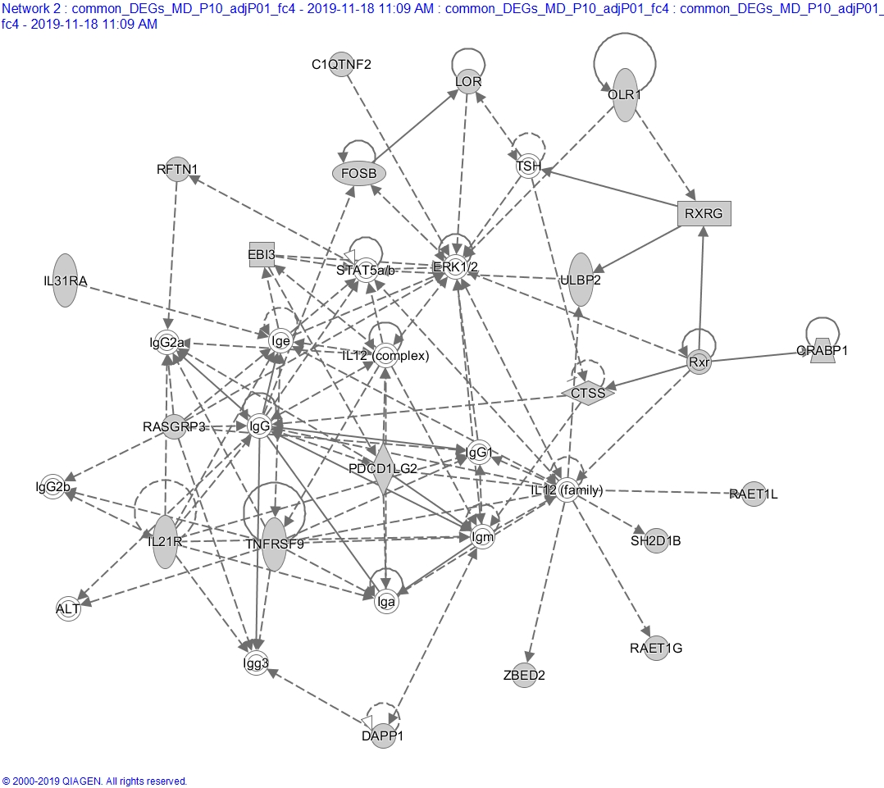

Slide 38
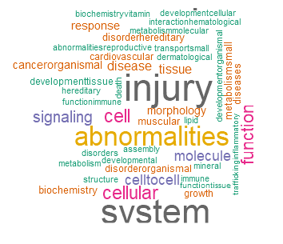
ESCC_196 signature -- disease cloud
https://2waybene.shinyapps.io/miRNATag/

Slide 39
Supporting slides

